Slide 1


Sreenidhi Institute of Science and Technology
Group Project
Topic :SmartDoor Using Facial Recognition
A Presentation by:
P Sanjeev Kumar M M Sai Prakash Venkat Rayapudi
17311A0437 17311A0438 17311A0445

Slide 2
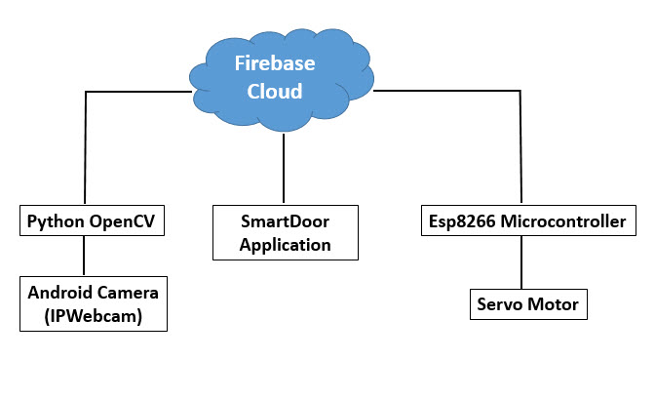
Block Diagram

Slide 3

Concept of Image processing
The analysis and manipulation of a digitized image, especially in order to improve its quality is known as image processing.
Here in this product image processing is done on the live video feed given to the program.

Slide 4
Image processing basically includes the following three steps:
Importing the image via image acquisition tools.
Analysing and manipulating the image.
Output in which result can be altered image or report that is based on image analysis.

Slide 5


Python programming is done for the image processing part.
Special open source libraries are used in the program, they are:
OpenCV
Numpy

Slide 6
Face Recognition Process
There are three stages for the face recognition as follows:
1. Collecting images IDs
2. Extracting unique features, classifying them and storing in XML files
3. Matching features of an input image to the features in the saved XML files and predict identity

Slide 7
Concept of IoT
The Internet of Things (IoT) is the network of physical devices, vehicles, home appliances, and other items embedded with electronics, software, sensors and connectivity which enables these things to connect and exchange data, creating opportunities for more direct integration of the physical world into computer-based systems, resulting in efficiency improvements, economic benefits, and reduced human exertions.

Slide 8

Firebase Cloud
A cloud by google, swift and fast!
Fastest MQTT
Firebase is Google’s mobile platform that helps you quickly develop high-quality apps and IoT applied products.

Slide 9
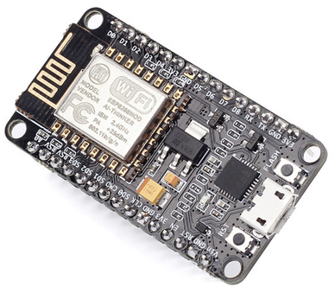
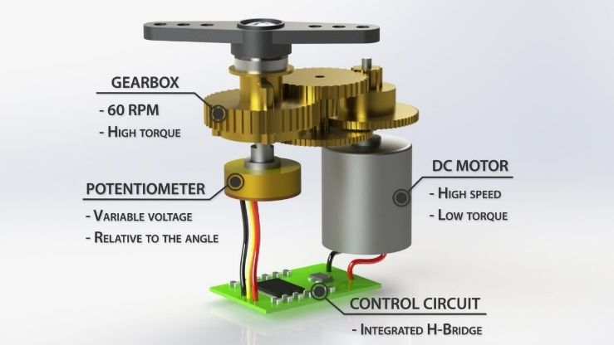
Main Components used
NodeMCU
Servo Motor

Slide 10

Arduino IDE
void setup()
void loop()
#include <ESP8266WiFi.h>
#include<FirebaseArduino.h>
#include <Servo.h>

Slide 11
Python OpenCV
import cv2,os
import numpy as np
from PIL import Image
from firebase import firebase
import urllib
import imutils
haarcascade_frontalface_alt2.xml

Slide 12


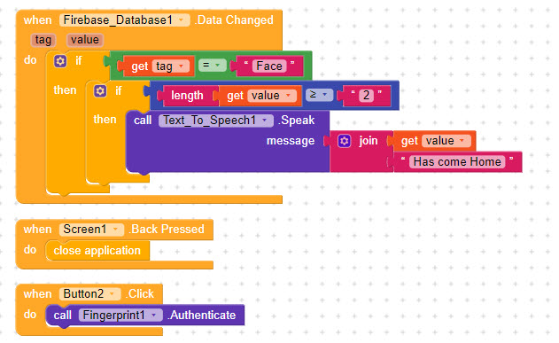

Slide 13
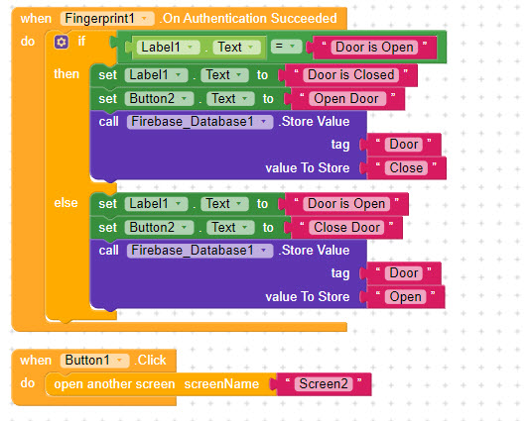

Slide 14
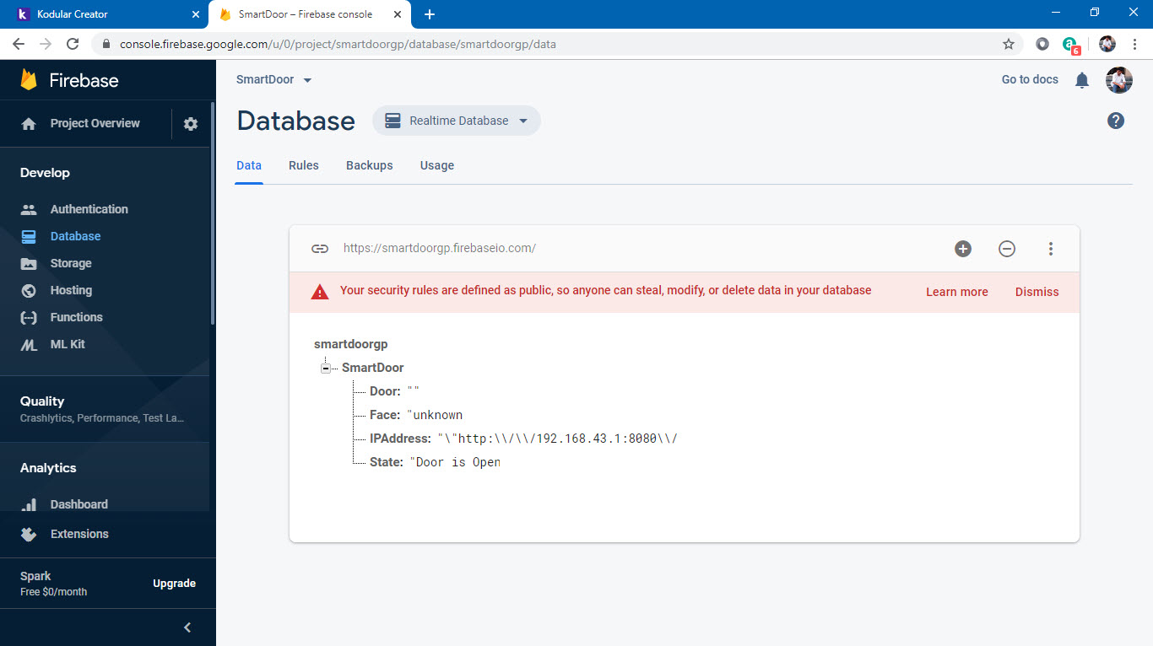

Slide 15
Thank You

